Slide 1
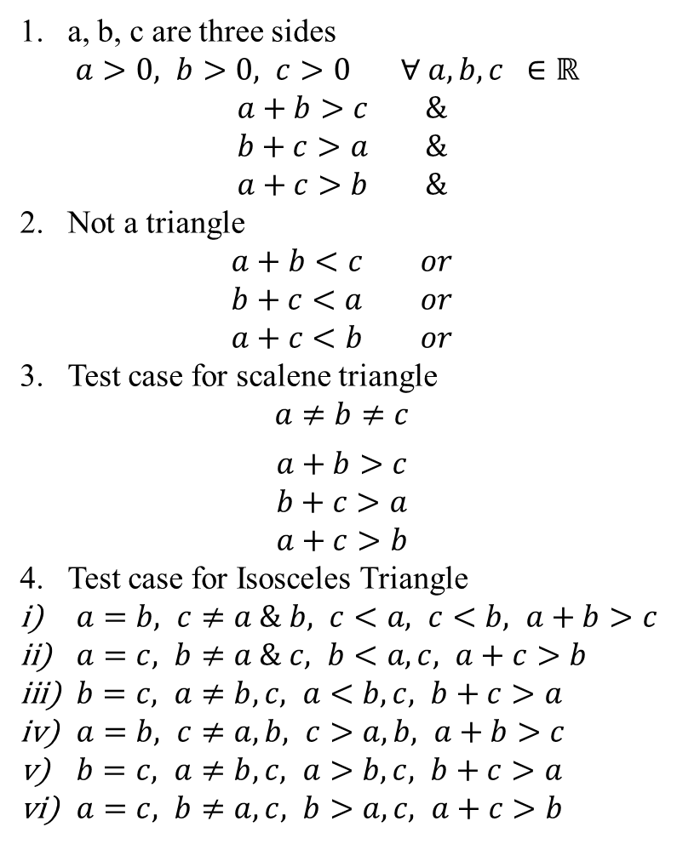
a, b, c are three sides
$a>0, b>0, c>0 ∀ a, b, c ∈ℝ$
$$a+b>c \&$$
$$b+c>a \&$$
$$a+c>b \&$$
Not a triangle
$$a+b<c or$$
$$b+c<a or$$
$$a+c<b or$$
Test case for scalene triangle
$$a≠b≠c$$
$$a+b>c$$
$$b+c>a$$
$$a+c>b$$
4. Test case for Isosceles Triangle
$a=b, c≠a \& b, c<a, c<b, a+b>c$
$a=c, b≠a \& c, b<a, c, a+c>b$
$b=c, a≠b,c, a<b,c, b+c>a$
$a=b, c≠a,b, c>a,b, a+b>c$
$b=c, a≠b,c, a>b,c, b+c>a$
$a=c, b≠a,c, b>a,c, a+c>b$

Slide 2
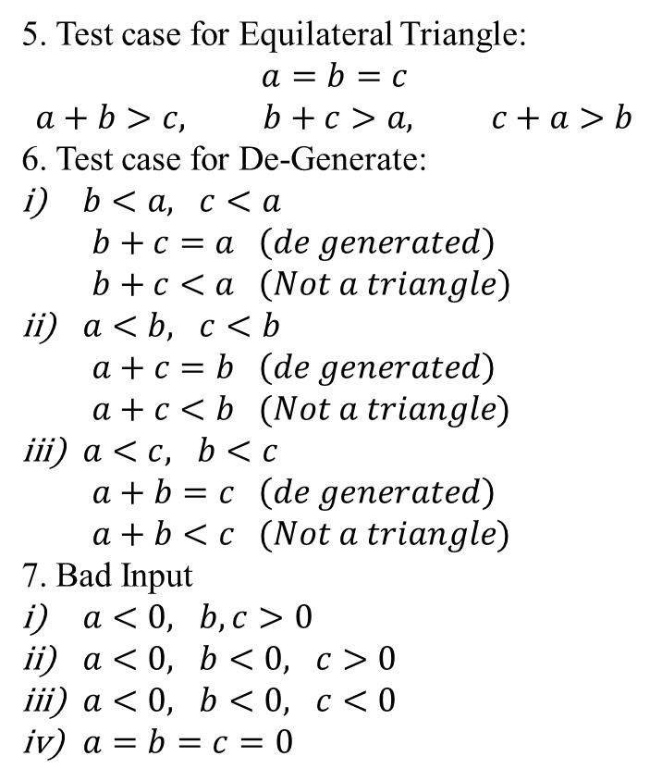
5. Test case for Equilateral Triangle:
$$a=b=c$$
$$a+b>c, b+c>a, c+a>b$$
6. Test case for De-Generate:
$b<a, c<a$
$b+c=a \left(de generated\right)$
$b+c<a \left(Not a triangle\right)$
$a<b, c<b$
$a+c=b \left(de generated\right)$
$a+c<b (Not a triangle)$
$a<c, b<c$
$a+b=c \left(de generated\right)$
$a+b<c (Not a triangle)$
7. Bad Input
$a<0, b,c>0$
$a<0, b<0, c>0$
$a<0, b<0, c<0$
$a=b=c=0$

Slide 3
Quality: Perspectives and Expectations Five major views according to (Kitchenham and Pfleeger, 1996; Pfleeger et al., 2002) are: transcendental, user, manufacturing, product, and value-based views, as outlined below:
In the transcendental view, quality is hard to define or describe in abstract terms, but can be recognized if it is present. It is generally associated with some intangible properties that delight users.
In the user view, quality is fitness for purpose or meeting user’s needs.
In the manufacturing view, quality means conformance to process standards.
In the product view, the focus is on inherent characteristics in the product itself in the hope that controlling these internal quality indicators will result in improved external product behavior (quality in use).
In the valued-based view, quality is the customer’s willingness to pay for a software.

Slide 4
People’s roles and responsibilities
When software quality is concerned, different people would have different views and expectations based on their roles and responsibilities. We can divide the people into two broad groups:
Consumers of software products or services, including customers and users, either internally or externally. Sometime we also make the distinction between the customers, who are responsible for the acquisition of software products or services, and the users, who use the software products or services for various purposes, although the dual roles of customers and users are quite common.
Producers of software products, or anyone involved with the development, management, maintenance, marketing, and service of software products. We adopt a broad definition of producers, which also include third-party participants who may be involved in add-on products and services, software packaging, software certification, fulfilling independent verification and validation (IV&V) responsibilities, and so on.

Slide 5
Subgroups within the above groups may have different concerns, although there are many common concerns within each group. In the subsequent discussions, we use external view for the first group’s perspective, who are more concerned with the observed or external behavior, rather than the internal details that guide to such behavior. Similarly, we use a generic label internal view for the second group’s perspective, because they are typically familiar with or at least aware of various internal characteristics of the products, in other words, the external view mostly sees a software system as a black box, where one can observe its behavior but not see through inside; while the internal view mostly sees it as a white box, or more appropriately a clear box, where one can see what is inside and how it works.

Slide 6
Hierarchical framework for quality definition, organized into quality characteristics and sub characteristics There are six top-level quality characteristics, with each associated with its own exclusive (non-overlapping) sub-characteristics, as summarized below:
Functionally: A set of attributes that bear on the existence of a set of functions and their specified properties. The functions are those that satisfy stated or implied needs. The sub-characteristics include:
Suitability
Accuracy
Interoperability
Security

Slide 7
Reliability: A set of attributes that bear on the capability of software to maintain its level of performance under stated conditions for a stated period of time. The sub-characteristics include:
Maturity
Fault tolerance
Recoverability
Usability: A set of attributes that bear on the effort needed for use, and on the individual assessment of such use, by a stated or implied set of users. The sub-characteristics include:
Understandability
Learnability
Operability
Efficiency: A set of attributes that bear on the relationship between the level of performance of the software and amount of resources used, under stated conditions. The sub-characteristics include:
Time behavior
Resources behavior

Slide 8
Maintainability: A set of attributes that bear on the effort needed to make specified modifications. The sub-characteristics include:
Analyzability
Changeability
Stability
Testability
Portability: A set of attributes that bear on the ability of software to be transferred from one environment to another. The sub-characteristics include:
Adaptability
Installability
Conformance
Replaceability

Slide 9
Definitions: Error, fault, failure, and defect
Key to the correctness aspect of software quality is the concept of defect, failure, fault and error. The term “defect” generally refers to some problem with the software, either with its external behavior or with its internal characteristics.
Failure: The inability of a system or component to perform its required functions within specified performance requirements.
Fault: An incorrect step, process, or data definition in a computer program.
Error: A human action that produces an incorrect result.
Therefore, the term failure refers to a behavioral deviation from the user requirement or the product specification; fault refers to an underlying condition within a software that causes certain failure(s) to occur; while error refers to a missing or incorrect human action resulting in certain fault(s) being injected into a software.
We also extend errors to include error sources, or the root causes for the missing or incorrect actions, such as human misconceptions, misunderstanding, etc. failures, faults, and errors are collectively referred to as defects.

Slide 10
Concepts and relations illustrated
The concepts of error (including error source), fault, failure, and defect can be placed into the context of software artifact, software development activities, and operational usage, as depicted in Figure 2.1. Some specific information illustrated include:
The software system as represented by its artifacts is depicted in the middle box. The artifacts include mainly software code and sometime other artifacts such as designs, specifications, requirement documents, etc. The faults scattered among these artifacts are depicted as circled entitles within the middle box.
The input to the software development activities, depicted in the left box, include conceptual models and information, developers with certain knowledge and experience, reusable software components, etc. Various error sources are also depicted as circled entitles within this left box.

Slide 11
The errors as missing or incorrect human actions are not directly depicted one box, but rather as actions leading to the injection of faults in the middle box because of some error sources in the left box.
Usage scenarios and execution results, depicted in the right box, describe the input to software execution, its expected dynamic behavior and output, and the overall results. A subset of these behavior patterns or results can be classified as failures when they deviate from the expected behavior, and is depicted as the collection of circled failure instances.

Slide 12
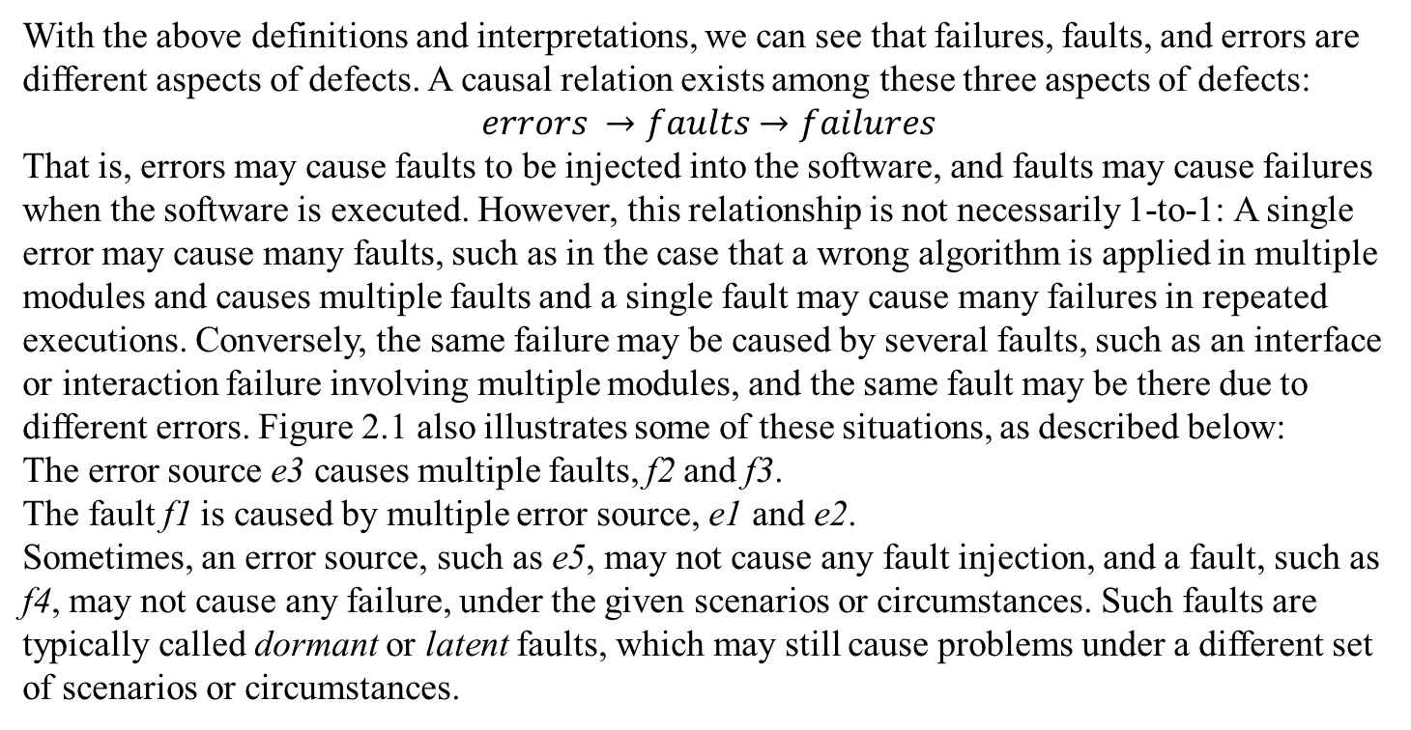
With the above definitions and interpretations, we can see that failures, faults, and errors are different aspects of defects. A causal relation exists among these three aspects of defects:
$$errors →faults→failures$$
That is, errors may cause faults to be injected into the software, and faults may cause failures when the software is executed. However, this relationship is not necessarily 1-to-1: A single error may cause many faults, such as in the case that a wrong algorithm is applied in multiple modules and causes multiple faults and a single fault may cause many failures in repeated executions. Conversely, the same failure may be caused by several faults, such as an interface or interaction failure involving multiple modules, and the same fault may be there due to different errors. Figure 2.1 also illustrates some of these situations, as described below:
The error source e3 causes multiple faults, f2 and f3.
The fault f1 is caused by multiple error source, e1 and e2.
Sometimes, an error source, such as e5, may not cause any fault injection, and a fault, such as f4, may not cause any failure, under the given scenarios or circumstances. Such faults are typically called dormant or latent faults, which may still cause problems under a different set of scenarios or circumstances.

